Slide 1
Dialog(UE) Fragments
IN721 2016
Design and Development for Mobile Devices
Session 6.2
Notes:
Last time we made our own descendents of the Android Fragment class.
Today we are going to look at some of Android’s descendants from Fragment.
As always with a descendent class, these inherit all the data and behaviour of the base class (e.g. they have a complete life cycle and are embedded in Activities), and extend that class to incorporate and encapsulate some important functionality.
We will start with the Dialog Fragments. As you would expect, these add typical behaviour for presenting user dialogues.
By using the descendent class, some of the stuff we need to make dialogues happen is written for us, saving us time if compared to a “start from scratch” approach.
When we create our own Fragment instances for dialogue, we will descend from the DialogFragment class (that is, we make a grandchild of Fragment). That way we get everything Fragment has and everything DialogFragment has, and then we add our own customisation.
To clear up the spelling issue: Android spells it the without the ue. To avoid confusion, I am going to follow that spelling, even in text. Sometimes we just have to be flexible.

Slide 2
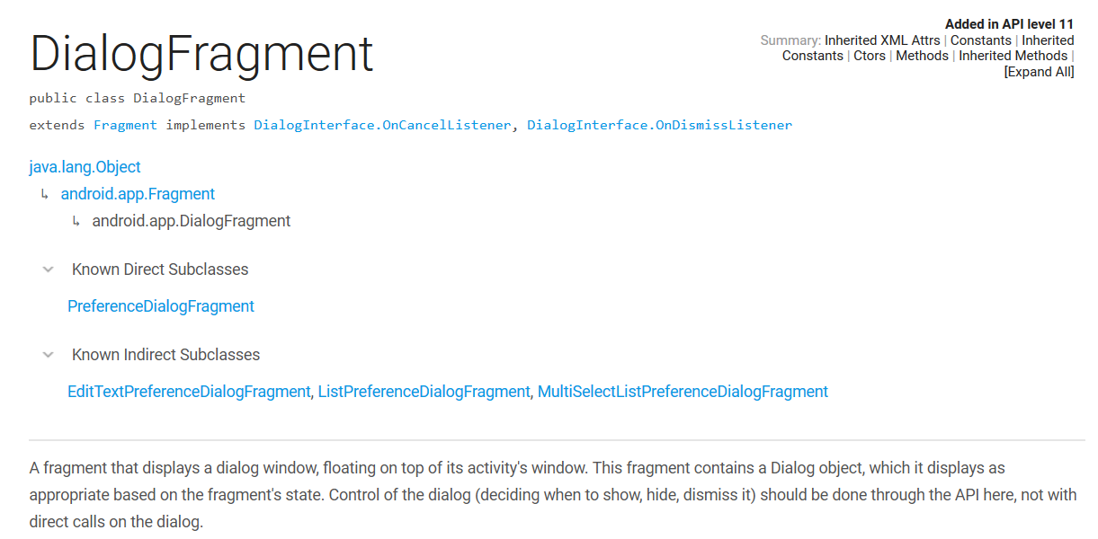
DialogFragment
http://developer.android.com/reference/android/app/DialogFragment.html
Notes:
By now, you know enough about Android that the formal documentation will start making sense.
So let’s begin there…
The documentation shows that this will be a Fragment (own life cycle, events etc.) but instead of embedding it in the Activity’s layout, it opens in its own little window (actually a Dialog object) hovering over its Activity.

Slide 3
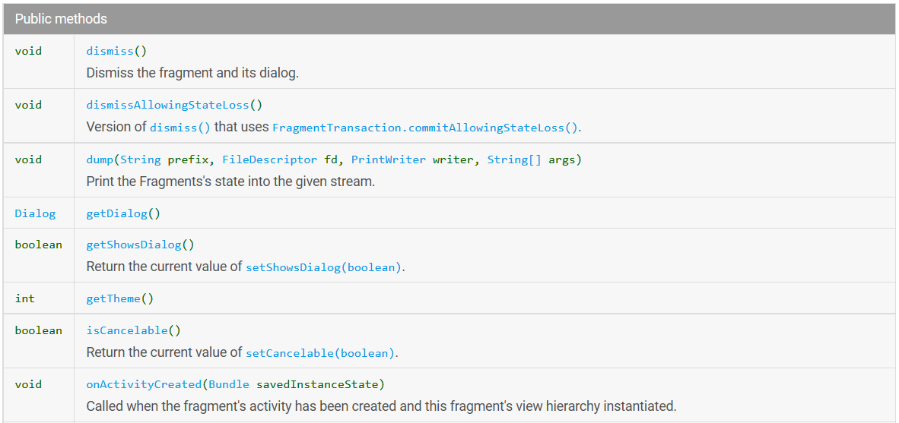
DialogFragment Methods
…
Notes:
Some methods
Dismiss() to get rid of it (like close)
getDialog() to get the actual window object. This is how we will set the title (on themes where this is an option)
Some more and still some more...

Slide 4
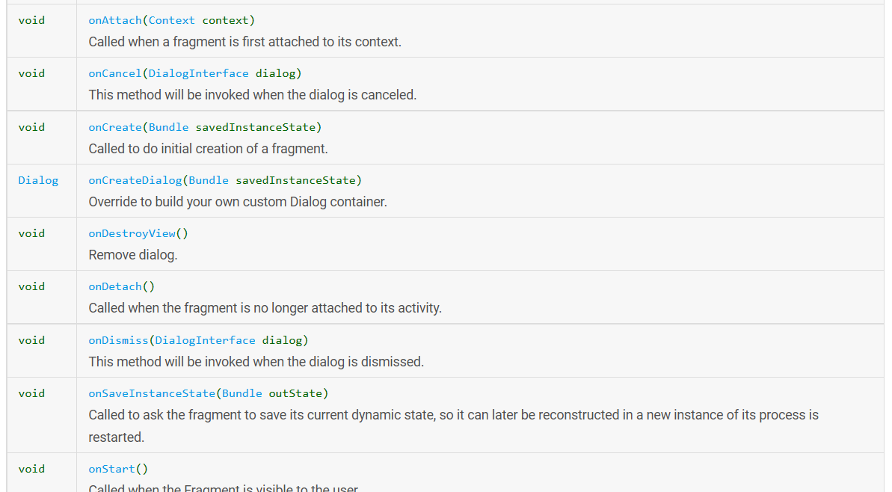
DialogFragment Methods
…
Notes:
The class has a lot of methods. All of these are extra things that a Fragment can use to be a good dialog fragment.
We won’t learn them all – we’re going to look just at the basic functionality.
But if you want more fancy stuff, you can come here to the docs and learn about the other things they can do.
Let’s start with the most basic dialog possible – just a window with some content.
It will appear hovering over our main activity, and the user can just click anywhere outside it to get rid of it.
We need a layout file (XML) for the dialog window.
We need a new Java class, descending from DialogFragment…
NB: This isn’t in the “Add new Android things” menus. You have to do it manually.

Slide 5
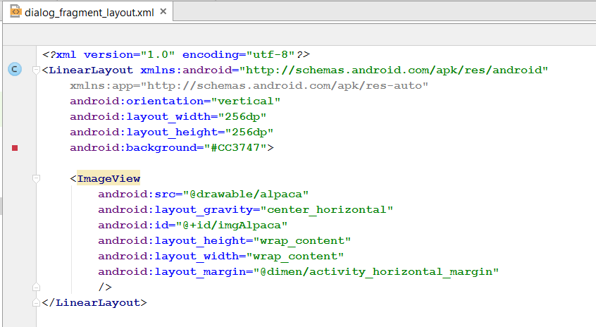
The XML Layout file
Notes:
Just a normal linear layout with an image view.
But the whole thing is size-fixed to be smaller – so it will appear as a little dialog pop-up, not a screenful.
I have set the background colour of the linear layout so you can see it better in graphical view
Note that in the Graphical Layout view at design time, it doesn’t look as it will at run time. The Graphical Layout tool really just pretends everything is an activity and draws it roughly.
Don’t worry about this; it will look correct at runtime.
Here is the layout in Graphical view.

Slide 6
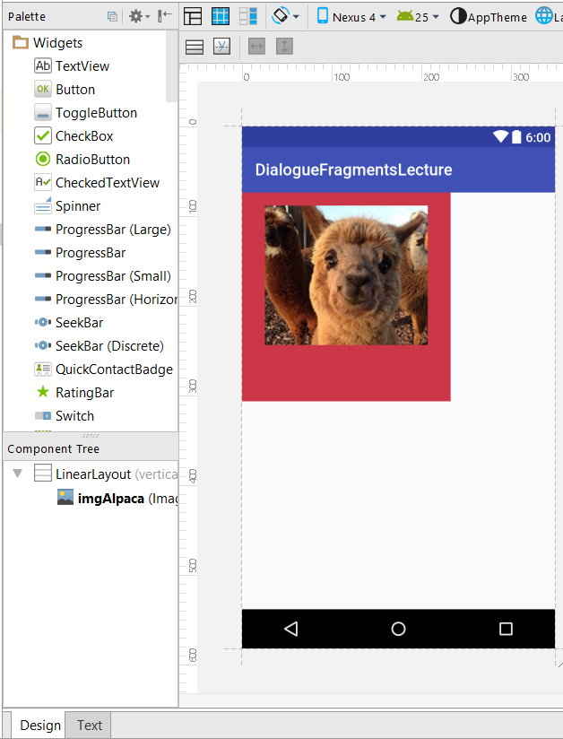
Graphical Layout != Accurate
Notes:
The linear layout is the pinkish background.
Again, at run time it will be a nice little hovering window. We will see that image in a moment.

Slide 7
The DialogFragment Class Code
Descend from DialogFragment
Override onCreateView
  Inflate the layout to get a view
  Do any necessary setup of the view
  Return the view
Notes:
Much of this is similar to the plain fragments, but we need to add this class manually (or modify the auto-added Fragment)
The dialog object is an actual operating system window. The LinearLayout sits inside the window.
You have more control over this window – you can, for example, add chrome and a title. See documentation regarding styles for details.
We will also see shortly how to get response buttons...
So, let’s see what it looks like for our simple dialogFragment…

Slide 8
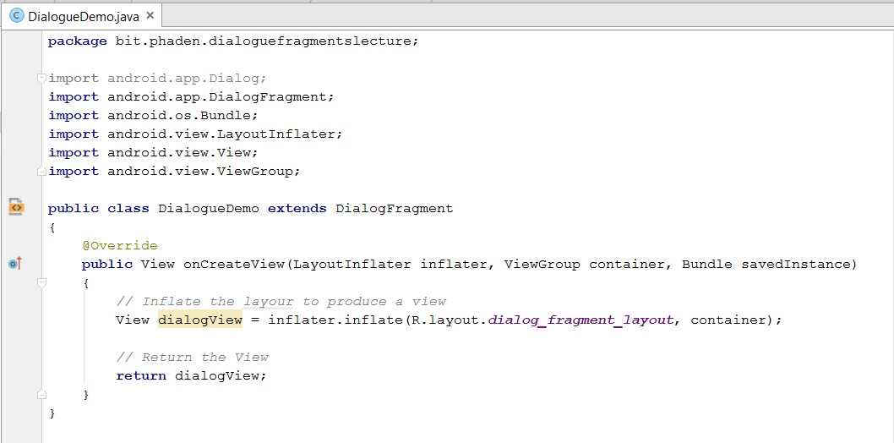
The DialogFragment Class Code
Notes:
No setup here. We’ll see some of the options in a bit

Slide 9
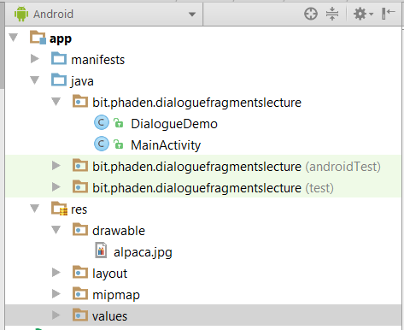
Technical Issue
Notes:
Make sure you get your new class into the right package, the same one as MainActivity.
When creating new classes in AS, it is easy to accidentally have them end up in other places.
If that happens, just drag the class to the correct spot.

Slide 10
Displaying the DialogFragment
Like all Fragments, your custom DialogFragment can only exist in an Activity.
Unlike the Fragments we looked at last time, we are not replacing any part of the Activity with the DialogFragment.
Steps:
  Get a FragmentManager
  Create an instance of your DialogFragment class
  Call the DialogFragment’s “show” method, passing in the FragmentManager and an identifying string.
Notes:
This actually makes it simpler to display the dialogFragment in that it doesn’t need to be atomic.
The procedure has just three steps.
Again, we see an unfortunate syntactic inconsistency here. We just have to deal with it.
In our example, let’s put the code in a button click handler, which we will wire up to a button on our main activity…

Slide 11
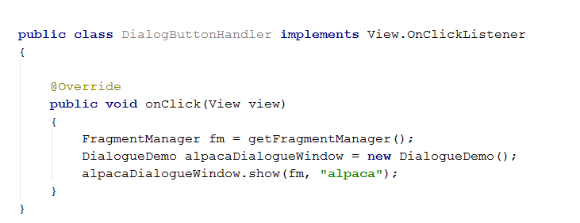
Displaying the DialogFragment
Notes:
See the three steps
The tag thing isn’t relevant in this example, but imagine you have an Activity that flings dialogues up all over the place.
Because it is a Fragment, it has an independent life cycle and can be kept alive and on the stack after it is created (this may be necessary for performance, but is out of scope at this time). So you can have bunches of dialogues in memory and you may need to be able to search for a particular one. You can do this with the tag.
Here’s how our app works…

Slide 12
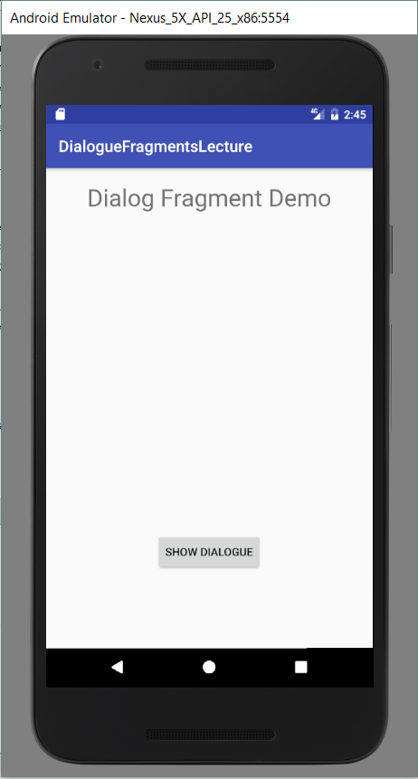
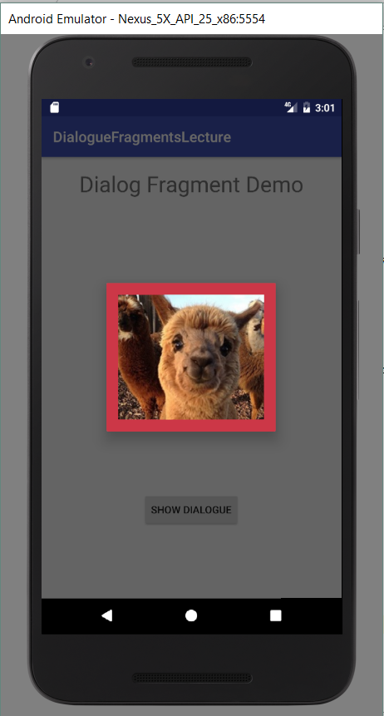
The App
Notes:
Our main activity is just a normal LL with a Button in it
When you click the button, you get this nice visual feedback effect with the Activity greyed out and the dialog hovering above.
Clicking anywhere outside the dialogue window dismisses it.
This is an excellent way to present modal (i.e. requires an action) information to the user.
NB: If you are working on a laptop and don’t’ get that behaviour, look into getDialog().setCanceledOnTouchOutside(true);
Note that to precisely manage the Dialogue’s lifecycle and stack, you will need to write more complex event code. See the docs as required.

Slide 13
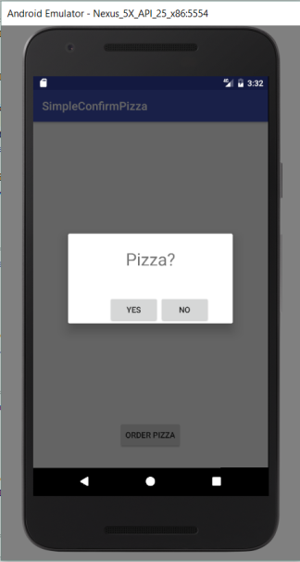
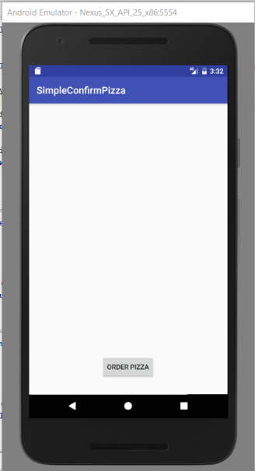
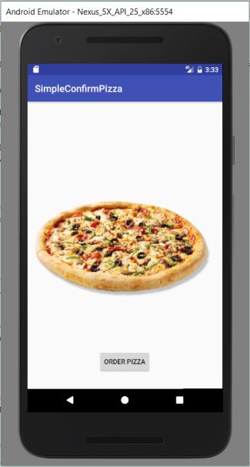
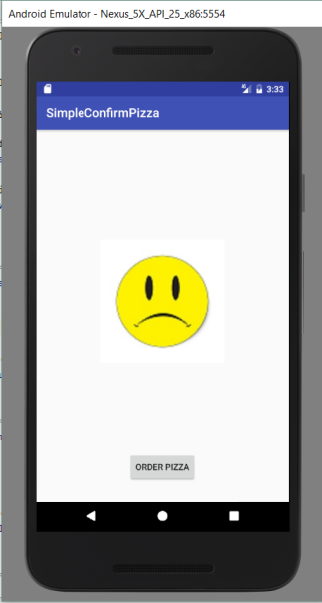
Communication Between Fragment and Activity
Notes:
Sometimes we just want to show a message to the user, but often we use a dialogue when we want to get some information from the user.
A very common example is the confirm.
Imagine this little app for ordering pizza.
Assume all the specifying the pizza toppings happens before this part, and the sending a message to the restaurant happens after. We are looking just at the process of confirming via a dialogue.
On the first screen we have the order button. Pressing it brings up the confirm (here a DialogFragment with two buttons). If the user presses Yes, we order (indicated here by the appearance of the pizza image). If the user presses No, we don’t order (indicated here by the sad face).
So somehow, the Activity has to be informed which button on the Fragment was clicked. How can we do this?
We have to think about who is alive when, and who knows about whom.
The Activity creates the Fragment, so it knows about it (i.e. it has a reference object through which it can refer to it), but when the Fragment is showing, it has the foreground and it receives the user button clicks. So the Activity can’t “listen” for button clicks to the Fragment. Only the Fragment can do that.
So the button click handler code for the Yes and No buttons will go to the Fragment, not the Activity. Only the Fragment can observe which button is clicked.
However, also remember that the Fragment can get a reference to his Activity (via his getActivity method). So he knows which button is clicked, and he knows who his Activity is. All he needs is some way to pass that information along to his Activity.
Let’s think about how data is usually passed along from one class to another. A very common example is when one class instance changes the value of some other class instance’s properties. In C++, for example, the gameManager class often changed the value of a Sprite’s location properties. How did the gameManager do that? => He called sprite.setLocation, passing in the new value.
That is, he called a method provided by the receiver. That is the pattern we can use here.
If the Activity provides a method that takes in the data the Fragment wants to pass, the Fragment simply grabs a reference to his Activity and calls the method, passing in his data as an argument.
Let’s look at the pattern schematically..

Slide 14
Communication Between DialogFragment and Activity
The Activity
  Defines a method that accepts the data it will want from the DialogFragment
  Creates and shows the DialogFragment
The Fragment
  Has event handlers for the user controls.
  When it has the data from the user action, it calls the method provided by the Activity, passing in the data.
Notes:
The timecourse of the data flow...

Slide 15
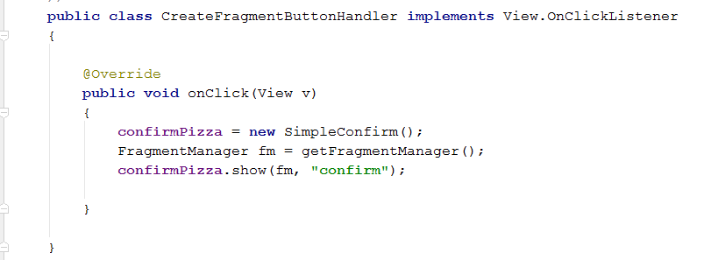
The Activity
The button click handler to create and show the Dialog Fragment
Notes:
This is exactly the same as the simple “show a picture” one we saw before.
The Activity doesn’t worry about what’s on the DialogFragment – that’s not his responsibility. He just shows it.
Note that he is hanging onto that reference. That is, confirmPizza is a class field declared at the top. Think about why an Activity might want to hold a reference(s) to its Fragment(s)

Slide 16
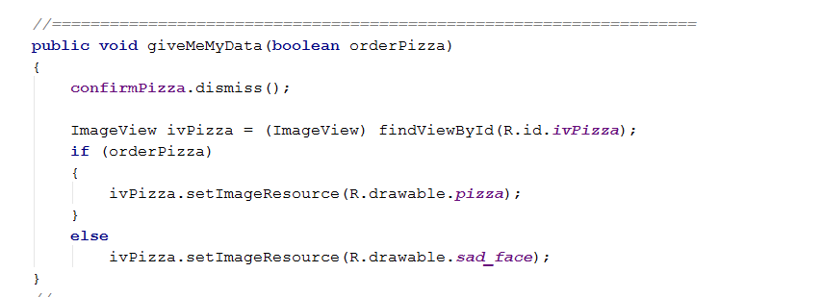
The Activity
The method for getting the data
Notes:
And here is the method he provides. It is declared in the class in the normal way for class methods, (outside of the onCreate, of course).
He wants a boolean. If it’s true he shows the pizza, if it’s false he show the sad face.
He also dismisses the dialogFragment. That’s why he needs to hang onto the reference.
Looking ahead just a little, what will the DialogFragment code be like? => In the button handler for Yes he will call giveMeMyData(true) and in the button handler for No, he will call giveMeMyData(false)
Here is the whole Activity class. The two methods we have seen, plus the onCreate where the button is wired up.

Slide 17
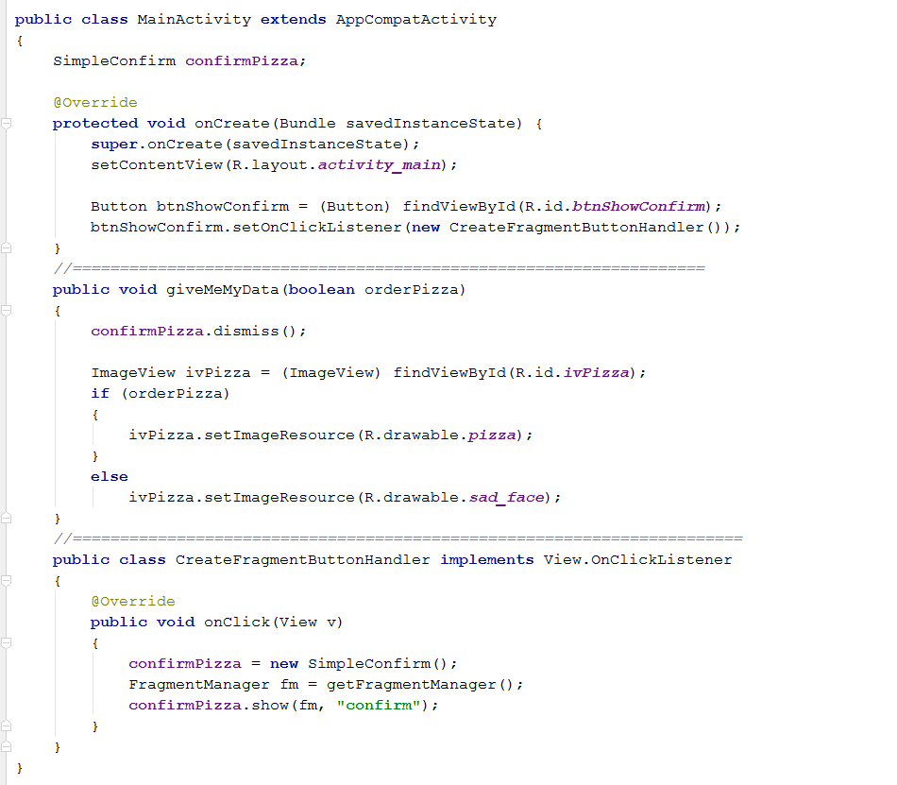
The Activity
Notes:
Here’s the whole thing
Now, let’s look at the Fragment..

Slide 18
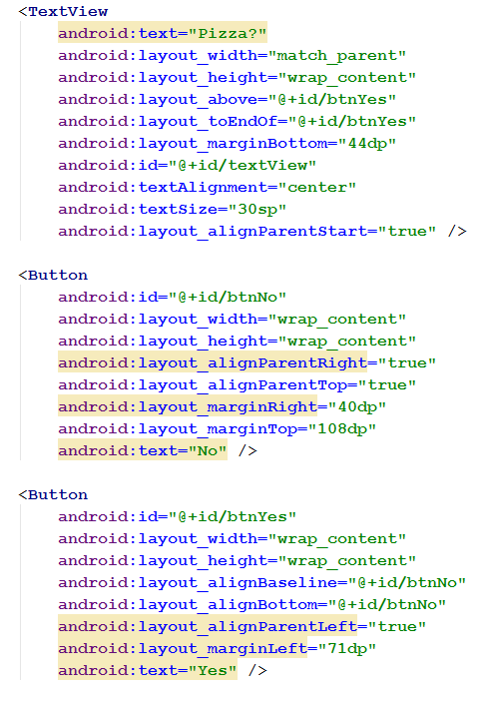
The Fragment Layout
Notes:
First of all, here is his layout.
Just a textview and two buttons in a RelativeLayout (too big to fit on screen).
You will notice that this actually makes a pretty budget-looking dialogue.
Next time, we will see a way to get Android to help us make a better-looking one.
But for now....

Slide 19
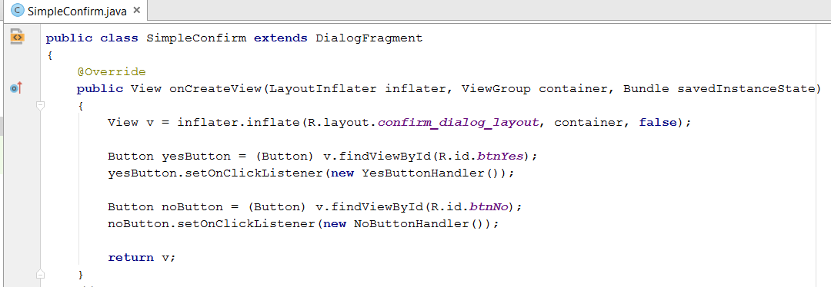
The Fragment Code
Notes:
Here is his onCreateView
As expected, he inflates his layout.
Here, he also wires up his two buttons. We will see the code for those handlers in just a second.
When the view is all prepared, he returns it.

Slide 20
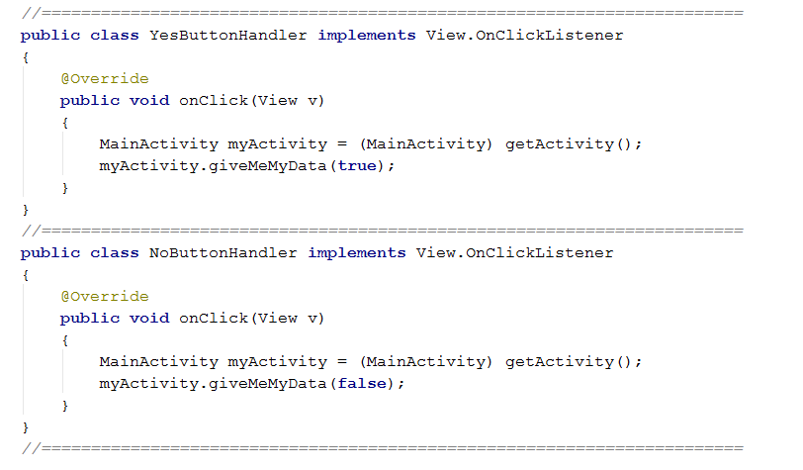
The Fragment Code
Notes:
Here are his button click handlers.
Just normal OnClickListener stuff.
He uses the method his Activity has provided to him...
When the user clicks yes...He gets his activity and calls the method giveMeMyData, passing true.
Note the cast. getActivity returns an Activity. You have to tell the compiler what type of Activity descendent it is, or it won’t be able to access any new methods you have defined in that child
And when the user clicks no...the same thing, passing false.

Slide 21
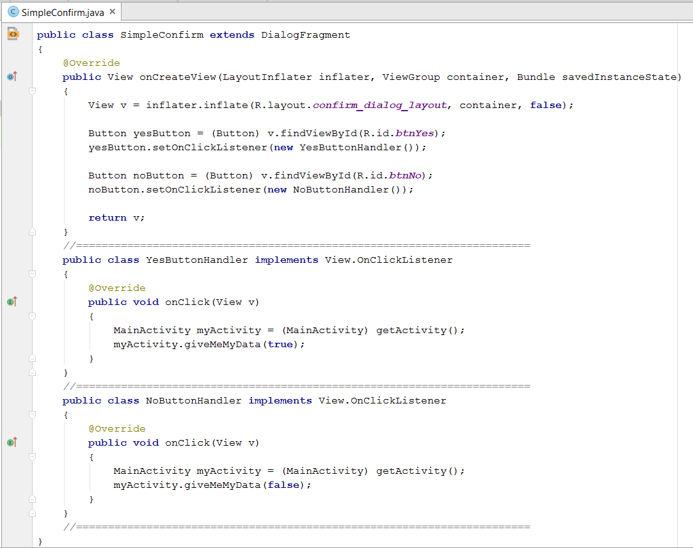
The Fragment Code
Notes:
And here is the whole class code all together, just to confirm that this is all that’s needed.
When you get the Activity and the Fragment implemented, the app works as shown earlier.

Slide 22
Safe Code Reuse?
What happens if we try to use this DialogFragment with an Activity that doesn’t define giveMeMyData?
Solution:
  Let the DialogFragment class define an interface that contains the data passing method(s) it needs access to.
  Make the Activity implement that interface.
The Interface Design Pattern
Notes:
Slight aside (OOSDers should ponder this).
Remember that one of the big advantages of Fragments is that after you write them, you can lift them up and stick them in any Activity?
So what happens if we try to use this DialogFragment in an Activity that doesn’t define giveMeMyData? => KaBoom!!
How can we protect ourselves against this?
Do you remember a circumstance where a class was obligated to implement a method, or the compiler wouldn’t compile? => interfaces.
If a class implements an interface, it has to provide code for all the methods in that interface.
So we can do this...
The class defines the interface inside itself, just like an inner class.
Isn’t that beautiful? This is a “design pattern”. Specifically, it is the Interface Design Pattern. Or sometimes the Callback Interface Design Pattern.
Not required for this paper, but worth being aware of when you are ready to take your Android coding to the next level.

Slide 23
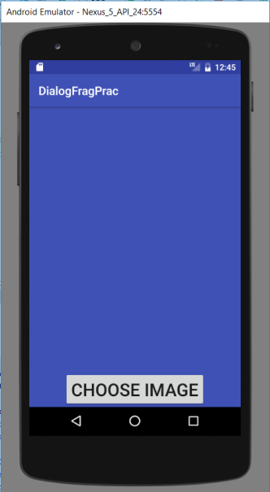
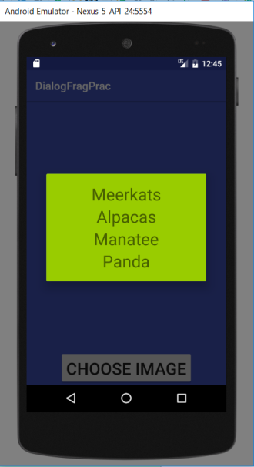
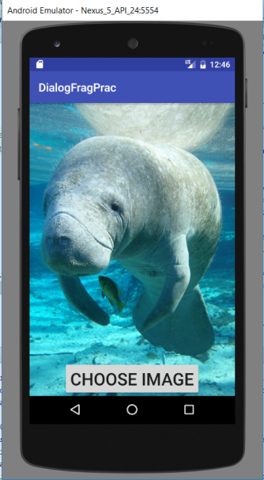
Practical Task 1
Make an app which uses a dialog fragment to let the user set the background image.
Present a list of strings; display the corresponding image.
Notes:
Opening screen
On button press, dialog pops up
On select, dialog goes away, and image background is shown
(Soon we will learn how to use the action bar instead of the big ugly button.)

Slide 24
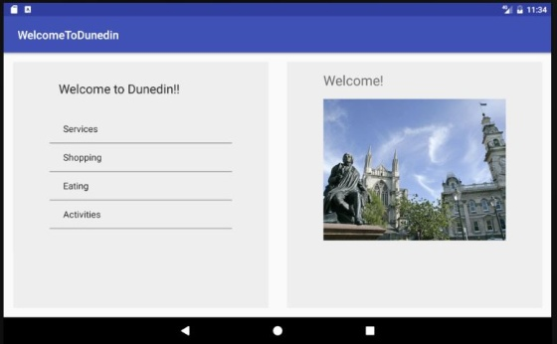
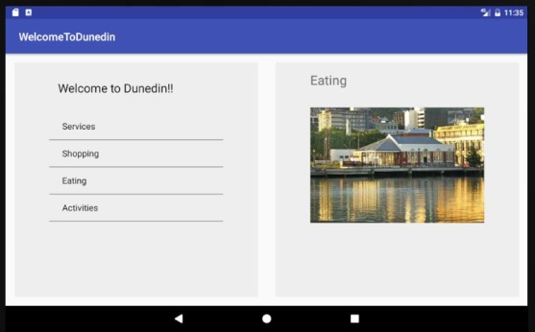
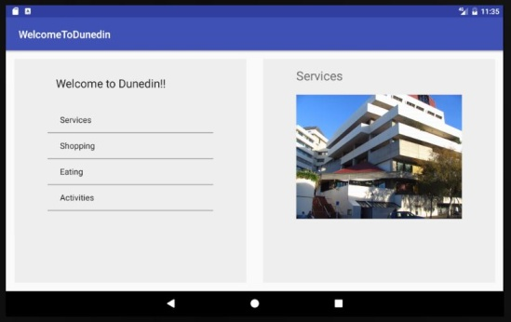
Practical Task 2
Refactor your “Welcome To Dunedin” app to run on a tablet, using fragments. Show the Navigation List and the Content Screen at the same time.
Optional Challenge Extension: Use only two fragments, one for the nav and one for the content, and simply update the content controls.
Notes:
Opening appearance. After “Eating”. After “Services”
The easiest way to do this is to have a separate fragment corresponding to each Activity in your original implementation (i.e. A Fragment for each page).
The nav fragment, when an item is selected, sends the clicked item info back to the Activity by calling a method which the Activity must provide (as in today’s lecture). The Activity then creates and displays the appropriate content fragment.
But this is a lot of classes and fussing about just to, effectively, change the contents of the text view and image view in the content fragment. It would be more efficient to leave the fragment there and just change its content.
To do this, you have to figure out some more data passing. Specifically: we know how to pass data from the Fragment to the Activity, but how can you pass data from the Activity to the Fragment?

